Slide 1
Annual Administrative Workshop

Slide 2
AGENDA
2024 Employee Benefits Program
Important Open Enrollment Dates and Notifications
What’s New for 2024
Benefit Offerings from Reta
Benefits Reminders
HSA Payroll Process / Updates
BAS Statements / Benefit Class Changes
Insurance Waivers
Qualifying Life Event Process
SunLife – EOI & LTD
Portability vs Conversion
Retirement
403(b) Loan Process
Personnel Reminders and Updates
Personnel Forms
Personnel Handbook Updates
Orientation Process
HR Record Retention
Benefit Eligibility
Transition of Key Players
Lay Personnel Background Check
Live Scan/Safe Haven
Sexual Harassment Training
LOA’s and W/C Cases
Insurance Stoploss
Termination Requirements
ADP Rollout
Misc. Payroll Items
Workplace Violence Policy and Training
Breakroom Postings
COVID Items
Equifax and The Work Number
Weekly News on Website
Increased Insurance Premium
Miscellaneous Bookkeeping Items

Slide 3
2024 Employee Benefits Program

Slide 4
Open Enrollment 2024
Open Enrollment Period:
Monday April 29th – Wednesday May 15th at 11:59 P.M.
Coverage and premium cost share will become effective July 1, 2024 and last until June 30, 2025.
Passive Enrollment
If employees do not go online to elect coverage, their existing benefits will default to current coverage and tiers.
Changes are not allowed outside Open Enrollment- unless employees experience a Qualifying Event. Examples can be found in the Employee Benefits Guide.
Training Tuesday’s will continue to offer training for administrators at 11 am
April 23 – Open Enrollment Training
May – All Month – Open Enrollment Training
June 4th & 11th – Post Open Enrollment Training
Notes:
The 2024 open enrollment will take place from 04/29-05/15 for changes effective 07/01/24. A Passive OE will occur for group health insurance. This means that if employees do not go online to elect coverage, their existing benefits will default to current coverage and tiers.

Slide 5
enrollment process
The benefits open enrollment process is completely online through RetaEnroll 360
Reta Trust registered users will receive communication from Reta about what’s coming for the new plan year closer to open enrollment date.
The enrollment site is available 24 hours a day, 7 days a week during the Open Enrollment period. Steps for completing online benefits elections:
Go to www.retatrust.org and click the Log In button in the top right hand corner.
Enter your User Name and Password.
Follow the easy enrollment steps in the Open Enrollment Wizard.
Review and confirm your elections, making changes as necessary.
Print your benefits confirmation statement.

Slide 6
What’s New for 2024?
Reminder: Reta’s integrated wellness plans are now offered through Reta’s medical plan providers: Kaiser Workforce Health and BSC Wellvolution
MyCatholicDoctor programs offered by BSC and now Kaiser
Reta will be offering MCD natural family planning care for Kaiser members at no additional cost.
Medicare pop-up reminders when an employee reaches age 65.
Educational presentations will be available for employees to view
Letters will also be sent to those employees who qualify for Medicare
Medicare Assistance Program through SGIA will be available to all benefit eligible employees to guide through the process
Notes:
MyCatholicDoctor (MCD) is a nationwide Catholic faith-based medical group with over 100 providers that primarily offer virtual telehealth appointments. They practice evidence-based medicine with a Catholic perspective that integrates Catholic spirituality into their care. Reta will be offering MCD natural family planning care for Kaiser members beginning on January 1, 2023 at no additional cost.
Reta introduced MCD to our members enrolled in BSC in July of this year. BSC members will continue to have access to the MCD national network at no additional cost for services, including virtual primary care, restorative reproductive medicine, natural family planning, mental health, adolescent medicine, and end of life programs. MCD can also order labs, imaging, and prescriptions for Reta BSC members.

Slide 7
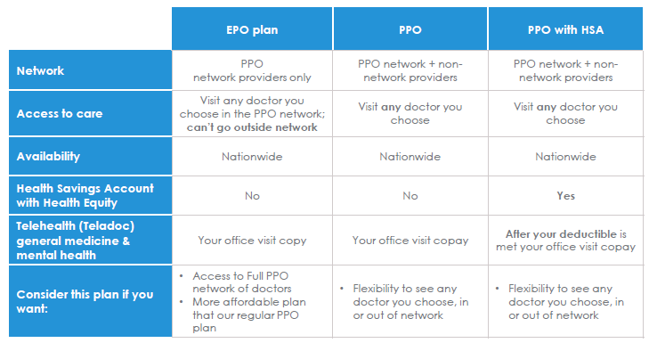
Blue Shield of California (BSC) Plans

Slide 8
Blue Shield EPO-5139 Plan
EPO gives you access to:
39,000+ doctors and specialists in BSC PPO network
Self-referral to specialists without a referral from a primary care provider
Care anywhere in the world through BlueCard
EPO does not cover:
Non-network services
It's important to know who participates in your EPO plan's network. If you go to a doctor or hospital that doesn't accept your plan, you'll pay all costs.
Notes:
EPO plan might be a good fit for you if you are looking for an affordable option and the flexibility to see a network of doctors and specialists without a referral.

Slide 9
Blue Shield PPO-5119 Plan
PPO gives you access to:
39,000+ doctors and specialists in BSC PPO network
Self-referral to specialists without a referral from a primary care provider
Care anywhere in the world through BlueCard
PPO also covers:
Non-network services
Notes:
PPO plans might be a good fit for you if you are looking for the flexibility to see both in and out of network of doctors and specialists without a referral.

Slide 10
Blue Shield HSA-5070 Plan
PPO with an HSA Plan offers:
39,000+ doctors and specialists in BSC PPO network
Self-referral to specialists without a referral from a primary care provider
Care anywhere in the world through BlueCard
PPO with an HSA Plan also includes:
Health Savings Account (HSA) with Health Equity to put aside tax-free money for qualified medical expenses
Roll-over and portable HSA funds for qualified medical expenses
You will pay for all covered services until you reach your deductible.
Notes:
PPO Savings plan might be a good fit for you if you are looking for an affordable PPO plan with the flexibility to set aside funds for future medical expenses and anticipate only needing services for primary care.
Balance that rolls over from year to year and is portable—you take it with you if you leave your job or retire

Slide 11
BSC Provider Network
To find doctors, urgent care centers, mental health providers and hospitals in California
blueshieldca.com/networkPPO
To find a doctor and hospitals throughout the United States (outside of California)
provider.bcbs.com
Access blueshieldca.com/watchfindadoctor to for quick video on the Find a Doctor tool
Notes:
In the unlikely event that your current in-network providers are not included in the BSC provider network, you can call the BSC Member Services team at 888-772-1076. BSC will support in-network coverage for one year.

Slide 12
Member ID card
Members will have one (1) ID card for their Healthcare and Pharmacy needs.
Same subscriber ID number for Medical and RX
Subscribers will receive 2 ID cards in a welcome letter per family. Only the Members name appears on the ID card.
How to get additional ID cards:
Call Member Services
Visit EngagementPoint at blueshieldca.com/engagementpoint
Notes:
With EngagementPoint, you can: • Access your Blue Shield health plan info, medical ID card, and more – all in one place. • Find a doctor, urgent care center, and more in your plan’s network. • Talk with a board-certified medical doctor or licensed mental health professional by phone or video through Teladoc. • Chat with a registered nurse who can provide health counseling and education. • Interact with a health coach who can help with disease prevention, nutrition, weight management, stress reduction, and management of chronic conditions such as diabetes, hypertension, and stress. • Connect with a social worker who can assess your emotional and psychological wellbeing. The social worker can also provide crisis intervention, substance abuse counseling, and mental health referrals.

Slide 13
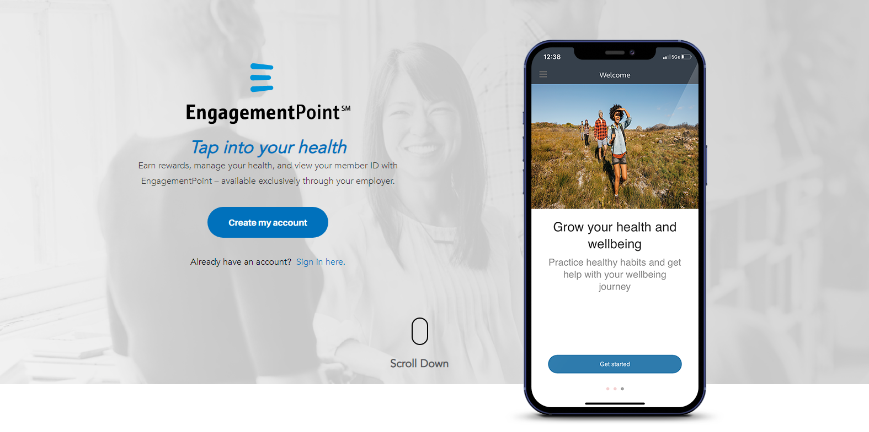
Blue Shield Engagement Point
Notes:
With EngagementPoint, you can: • Access your Blue Shield health plan info, medical ID card, and more – all in one place. • Find a doctor, urgent care center, and more in your plan’s network. • Talk with a board-certified medical doctor or licensed mental health professional by phone or video through Teladoc. • Chat with a registered nurse who can provide health counseling and education. • Interact with a health coach who can help with disease prevention, nutrition, weight management, stress reduction, and management of chronic conditions such as diabetes, hypertension, and stress. • Connect with a social worker who can assess your emotional and psychological wellbeing. The social worker can also provide crisis intervention, substance abuse counseling, and mental health referrals.

Slide 14
CVS Caremark (CVS)
Reta’s Pharmacy Benefit Manager
BSC members will receive Welcome Kits and a single ID card for BSC medical and CVS pharmacy benefits prior to July 1st.
Nationwide network of pharmacies that includes Walgreens, Walmart, local pharmacies and CVS stores.
Members can sign into their Caremark.com profile to locate an in-network pharmacy near them
CVS direct member outreach for formulary disruption and specialty medications
To see a list of CVS non-specialty medications visit https://www.caremark.com/portal/asset/Advanced_Control_Specialty_Performance_Drug_List.pdf
To see a list of CVS Specialty Formulary medications visit https://www.caremark.com/portal/asset/Advanced_Control_Specialty_Preferred_Drug_List.pdf
Notes:
Most pharmacies that participate in our National Network are connected to the Surescripts Network Alliance; approximately 95% of U.S. retail pharmacies participate in the network.
Through our Surescripts connectivity, retail pharmacies can:
•Identify members’ PBMs through their name, date of birth, gender and ZIP code
•Process the prescription drug claim at the point of service if members do not have their ID card or if they do not know their employer’s PBM
In addition, through CVS Pharmacy’s participation in the Surescripts network, we can identify

Slide 15
Health Equity
Reta is the HSA plan administrator
Members will receive the following:
Welcome Kit
New Health Equity debit card
PPD Account Numbers – Employee's direct deposit bank information
Notes:
Note: Members who are currently enrolled in a High Deductible Health Plan will not be issued a new debit card. If you need a PPD account number for a new HSA participant, please reach out to me to receive the account information.

Slide 16
Kaiser Permanente Plans
Notes:
No changes

Slide 17
Kaiser EPO-4063 Plan
Preventative care at little or no out-of-pocket cost
A personal doctor for routine medical care
No referrals needed for certain specialties, like optometry and obstetrics/gynecology
EPO plans do not cover care outside the Kaiser network unless it’s an emergency.
24/7 Away from Home Travel Line: 951-268-3900
Kp.org/travel
Kaiser provides the pharmacy benefits
Notes:
But there are a few things to keep in mind when you get preventive care:
Sometimes you’ll have preventive and non-preventive care in the same visit.
There’s no cost or a copay for most preventive care services, but you’ll have to pay extra if you have any non-preventive services.
For example, your doctor might find a mole during a routine visit and decide to remove it for testing.
Because the mole removal and testing are not preventive, you may be charged for these services.

Slide 18
Kaiser HSA-4085 Plan
Preventative care at little or no out-of-pocket cost
A personal doctor for routine medical care
Copays or coinsurance for most covered services after you meet your deductible
No additional coinsurance needed after the annual out-of-pocket maximum is met
A pre-tax health savings account to help pay for certain medical expenses
Kaiser provides the pharmacy benefits
Notes:
You’ll pay full charges for covered services (other than preventive services) until you reach your deductible.
After meeting your deductible, you’ll start paying less for these services — a copay or coinsurance — until you reach your out-of-pocket maximum.
If your family is covered under your plan, you’ll only have a family deductible and a family out-of-pocket maximum. When your family reaches the family deductible, everyone will start paying less than the full charges for covered services — a copay or coinsurance — for the rest of the year.
If your family reaches the family out-of-pocket maximum, no one in your family will have to pay for covered services for the rest of the year.

Slide 19
Delta Dental Plans

Slide 20
VSP Vision Plans

Slide 21
Reta’s Integrated wellness Programs
Wellvolution through BSC
Members will have 29 lifestyle well-being programs to choose from. And they will be eligible for disease prevention and condition reversal programs, which include intensive behavioral counseling for treating diabetes, hypertension, digestive health, obesity, and heart disease.
For complete details about Wellvolution, go to https://rbc-ihc.retatrust.org/?id=ab9b2b45c5c95e3c00b106993c1d5804&ft=onlyNetworks#medical-blue_shield_ca
Workforce Health through Kaiser
A health assessment, telephonic coaching and healthy lifestyle programs will be offered to members to help them reach their unique goals. And this information can be shared with the member’s care delivery team to provide a more holistic view of their patient’s health status.
Online healthy lifestyle programs, videos, podcasts, recipes and more
On-site health education classes and support groups (classes vary at each location and some may require a fee)
For complete details about Workforce Health, go to https://rbc-ihc.retatrust.org/?id=e7e142497f5cdba9b8dad86d36473e9d&ft=onlyNetworks

Slide 22
Administrator Notes
Invoices are generated on the 21st of every month
Invoices should be printed and compared to the ADP roster on a monthly basis to insure accuracy of employees being billed for
Review bill for any changes
Administrator accounts are separate from your employee account
There should be absolutely NO sharing of credentials
Administrator account must also be approved by the benefits administrator for the location
Notes:
If there is a new benefits administrator at your location they must complete the Administrator Account Access Request Form which they can obtain from me. The new benefits administrators must undergo finger printing and background check prior to receiving access. Approval from both is required.
No sharing of credentials regardless if it’s for a short period of time or that employee is on leave. All Admin authorizations must be done in the form provided by me. Please do not edit the form.

Slide 23
Benefits Reminders
Notes:
HSA Payroll Process / Updates
Priests included in BAS Statements
Insurance Waivers
Qualifying Life Event Process

Slide 24
HSA Payroll Process/Updates
Health Equity is the administrator for HSA plans.
HSA set-up in ADP WorkforceNow available at https://www.scd.org/sites/default/files/2020-12/HSA-Setup-in-ADP-111820.pdf
Please contact the Lay Personnel Office to obtain employee’s direct deposit bank information
Employee HSA payroll deduction form available at https://www.scd.org/sites/default/files/2023-12/Employee_HSA_Payroll_Deduction_Form%20%28December%202024%29.pdf
Notes:
For the 2024 year, the HSA max contribution for is $4,150 for self-only coverage.
The HAS max contribution for family coverage is $8,300.
These types of plans are design for people with high-deductible health insurance plans cover out-of-pocket medical costs. Contributions to HSAs aren’t subject to federal income tax.
The contributions are not uploaded from RETA, but from ADP deductions.

Slide 25
BAS Statements / Benefit Class
Monthly invoices are generated and emailed on the 21st of the month.
Invoices must be reviewed on a monthly basis.
Priest health premiums are included in BAS Statements
All Employees regardless of benefit eligibility must be in RETA to comply with ACA reporting
ADP / Reta Enroll
2024-2025 Benefits calculation worksheet (PT 10 & PT1001)
Benefit Class change must be done in RETA
Contact RETA Services if the employee will be changing from a class that is other than Benefit Ineligible
Notes:
Salaries must be updated in RETA every time there’s a change in wages because it affects the LTD amount. Please also update the employees address in RETA.
Complete a PT10 & PT1001 for each employee during Open Enrollment, when changes are being made, if a deduction payment was missed or as needed.
ACA (Affordable Care Act) Tax Provisions for Employers - It is enforced by the IRS to ensure that employers report health coverage information to the IRS and furnish statement to employees annually.
Changing a Benefit Class for an employee can be challenging for some. You must contact RETA Services when changing the Benefit Class for an employee.
If the employee will be Benefit Ineligible you must first term the employee in RETA to activate their COBRA Benefits and then add them as benefit ineligible employee.

Slide 26
Waiver of group health benefits
If an employee waives medical coverage, please provide them a waiver of group health benefits form.
Waiver form must be completed annually.
Waiver form: https://www.scd.org/sites/default/files/2024-01/Waiver%20of%20Group%20Health%20Benefits.pdf
Notes:
If an employee decides to take part in dental, vision or life coverage but not in the medical portion of the plan, a waiver is still needed. It is required for this form to be completed every year.

Slide 27
Qualifying life event process
Employees must complete qualifying life events electronically in RetaEnroll.
Employees will be prompted to upload proof documents specific to their Qualifying Life Event during the submission process.
Location Administrators must submit all Benefits Class changes to Reta Trust Customer Service at: service@retaenroll.org.
All life events for Reta are effective the 1st of the month following the date the Qualifying Life Event occurs. However, newborns are effective on the date of birth.
Instructions on how to submit a life event available at https://www.scd.org/sites/default/files/2020-01/RETA%20Life%20Event%20Model%20Employee%20%20%5B3%5D.pdf

Slide 28
SunLife - EOI & LTD
Evidence of Insurance (EOI)
Needed when amount requested is above the guaranteed amount of $200,000 for employee and $50,000 for spouse
Increments are higher than the allowed $10,000
If the employee did not elect Voluntary Life Insurance upon hire
If an employee is currently enrolled in Voluntary Life and only asks for an additional $10,000 during OE, then and EOI is not required
Long Term Disability (LTD)
Employee must be in an eligible benefit class and insured under the policy at the time disability commenced
Maximum benefit duration
60% of your Total Monthly earning as a monthly benefit after claim has been approved
Benefits begin 180 days from date of disability – “Elimination Period”
Claim should be submitted no more than 30 days before the end of the Elimination Period or within 30 days after the termination of the policy
COBRA benefits should start after the 6 months
Partner with Benefits Manager to complete process
Notes:
It is very important that upon hire the employee is aware of the EOI requirement. The approval of SunLife is required in order to be approved in RETA.
Reminder that SunLife and RETA are not connected to each other, they are two different portals. Admin do not have access to SunLife. All the SunLife approvals/denial come directly to me.
I then go in RETA and approve or deny the coverage. If no EOI is sent to SunLife the coverage will continue to say “Pending” on the benefit statement until it is resolved.
The EOI will be required even during Open Enrollment if it was not elected upon hire.
There is a Maximum benefit duration period. You can see the table on page 6 of the LTD policy. It ranges from age at disability, year of birth and normal retirement age.
We would like to be informed of any employee who needs or be needing to apply for LTD as they may be facing an illness, or disability that is already stressful enough.
The importance of making sure that the Salary amount is updated in RETA.
Social Security benefits do not interfere with the LTD process.

Slide 29
Portability & Conversion vs Conversion
Life Portability & Conversion
Employee meets one of the following:
Not Retiring
Or, 69 years old or younger
Or, is not disabled
https://www.scd.org/sites/default/files/2023-04/Life%20Portability%20and%20Conversion%20Comparison%20012020.pdf
Life Conversion
Employee meets one of the following:
Retiring
Or, over 70 years old
Or, is disabled
https://www.scd.org/sites/default/files/2023-06/Life-Conversion-Notice-June-2023.pdf
Notes:
There are two forms that are available for employees upon separation to continue their Life insurance coverage through SunLife.
Life Portability & Conversion and Life Conversion. Only one form should be given.
Policy number can be found on the first page of the SunLife booklet.

Slide 30
Retirement
Retirement
Send PT200 to Lay Personnel
Term Employee in RETA and ADP
Retirement Planning Checklist https://www.scd.org/sites/default/files/2017-06/THEDIOCESEOFSACRAMENTO-RETIREMENTMATERIALS.pdf
Notes:
When an employee is retiring it is recommended that you contact the benefits manager to see if employee takes part in the Lay Pension or 403(b).
This information will help in guiding you as to which forms the employee should receive upon separation.
If the employee is not termed in RETA or ADP, the Lay Pension process will not proceed.

Slide 31
403(b) Loan Process
403(b) Loan Process
The Standard allows for eligible employees to take part in the Loan Program.
Employees request the loan via loan process online
Loan shall be for a minimum of $1,000 and a max of no more than 50% of the Participants Vested Account Balance
Rate of interest is paid by participant
Loan repayment is done through payroll deductions and in equal installments over a period not to exceed five years; exceptions may apply
Payroll Administrators should be notified when an employee has requested a loan
Employees should notify the Payroll Administrator that they have taken out a loan
Loan Schedule
Payment to be included in the uploads sent to Veronica at Superior USA
Allow two payroll dates to see the payments applied online
Partner with Finance if need assistance on how to submit the uploads
Notes:
Loan exceptions to exceed the 5 years is for the purchase of the principal residence of the participant in which it shall not exceed 10 years.
Loan may be prepaid in full without penalty; partial payoffs are not allowed.
Loan schedule allows you and the employee to view when the loan will be paid in full and the amount that should be deducted via payroll.
If an employee separates employment before the loan is paid off, the plan administrator will offset the Participant’s vested account balance by the outstanding balance of the loan.
Loan default - If the missed installment payment(s) plus interest are paid in full to the Plan before the loan is declared in default, then the loan shall not be in default. The loan may be paid in full through your Employer or by certified funds (personal checks are not accepted)
All loans that go into default are reported to the IRS and participants will be sent a 1099 to report.
If a participant has an outstanding loan that has been a defaulted loan they are not eligible to an additional loan until they pay the existing loan.
There are some administrative costs that the participants pays when a loan is requested.

Slide 32
Personnel Reminders & Updates

Slide 33
Personnel Forms Best Practices
All forms are found on our Diocesan Website under the Lay Personnel page.
https://www.scd.org/lay-personnel/employee-forms
Date is listed when forms have been updated
Print forms as needed as updated regularly
PT10/PT1001 Form located on website
Paperwork required to be sent to Lay Personnel
i.e. PT 200 Personnel Transaction: Separation/Change
Notes:
Print forms as you go as we updated them periodically. If you are using forms that you have preprinted they may be outed. This can be a bigger issue if they are state required forms. For example, the I-9 and Pre-app/Application were updated in 2023.
Ensure the PT100 or PT200 are fully completed. Ensure the information provided on the a PT200 or a PT100 is always being updated in ADP and RETA. For example, if you submit a PT200 expressing that you have terminated an employee, then you need to process the termination in ADP and RETA. Failure to do so affects the individuals ability to receive their retirement benefits as well as costing the site undue expenses for medical premiums. Note: Original Hire Dates need to be accurate, contact the diocese before onboarding if the employee has previously worked in the diocese. This date needs entered in the hire date and rehire filed in ADP.
Follow the direction provided on the bottom of the form to determine if the form needs routed to the Diocese.

Slide 34
Personnel Handbook Updates
The following polices have been updated:
8.0 Fingerprinting/Background Checks
31.3 Sick Pay Policy
Revised Agreement Regarding Arbitration of Disputes
The following policies have been implemented:
31.5 Organ Donor Leave Policy
32.2 Reproductive Leave Policy
42.0 School Tuition Benefits Policy
All employees should have been provided with a copy of the updated Lay Personnel Handbook. The acknowledgement forms at the end of the handbook should have been signed by the employee and submitted back to you for their personnel file.
Notes:
Memo sent out on Dec. 18, 2023
There have been several updates made to the Lay Personnel Handbook, which will go into effect January 1, 2024. Below is an overview of the main changes but does not encompass all the changes. Please provide each employee with a copy of the revised Lay Personnel Handbook. Ensure each employee reviews the revised Lay Personnel Handbook in its entirety. The employee will then need to sign the acknowledgment forms from the back of the handbook and provide them to you no later than January 31, 2024. The signed acknowledgements must be placed in the employee’s personnel file. If the employee is a Diocesan employee, please send the acknowledgement forms to the Office of Lay Personnel.
In addition, the Arbitration Agreement has been updated and is now mandatory to sign. It is still a standalone document. The Arbitration Agreement will need to be provided to each employee as well. Once the agreement is signed by all parties, it will need to be placed in their personnel file no later than January 31, 2024.
Overview of Changes:
1. Revised 8.0 Fingerprinting/Background Checks
The policy has been updated to clarify the process of ensuring individuals with previous employment or a change in position are correctly vetted and cleared prior to beginning work or a new position.
2. Revised 31.3 Sick Pay Policy
The policy has been updated to reflect the new accrual and carry over caps required by state law for Occasional Part-Time Employees. The accrual cap has been increased to 40 hours a year and the carry over cap has been increased to 48 hours.
Note: No other class of employees are affected by the new state law as the Diocese already exceeds the expectations set by the state.
3. Revised Agreement Regarding Arbitration of Disputes
The revised Arbitration Agreement is a standalone document that is now required to be completed. This agreement is no longer optional.
Ensure that the Employer Name is filled in at the beginning of the document. Be sure to use the legal name of the organization such as Pastor of St. Mary Parish, Sacramento. Be sure to include the name of the city as we have multiple sites with the same name.
Note: Schools will use the same Employer Name as the parish, as you are under the same FEIN Number.
Ensure the form is also signed by the organizations designated representative (i.e. Pastor, Supervisor, Office/Business Manager).
New Policy:
1. New 31.5 Organ Donor Leave Policy
This policy is to be implemented at any location with 15 or more employees.
Eligible employees will be provided up to 30 days of paid leave in a one-year period when the employee participates in an organ donation, and up to five (5) days of paid leave to make a bone-marrow donation. Organ donors will additionally be provided with up to an additional 30 business days of unpaid leave in a one-year period.
Employees are required to provide Employer with written verification of their participation in either an organ donation or a bone marrow donation. The verification also must include a certification from the provider that the procedure is medically necessary.
2. New 32.2 Reproductive Leave Policy
This policy applies to eligible employees who have experienced a reproductive loss event such as a failed adoption, miscarriage, or stillbirth.
3. New 42.0 School Tuition Benefits Policy
This policy applies to eligible full-time employees who have children enrolled in schools overseen by the Catholic School Department.
Eligible employees may receive (1) a $500 discount off the annual tuition fee of each student at a parish or diocesan school and (2) free extension care at a parish school.
Discounts are limited to the children or grandchildren of the employee when the employee is paying the tuition.

Slide 35
Orientation Process
Using New Hire Checklist
Ensure Pre-Application and Application is completed before moving to hire
Pre-hire Section
Ensure clearances are obtained
If previously employed in the Diocese, ensure they left in good standing
Post-hire Section
Onboarding, Memo for State Forms
Ensure all required clearances have been completed before entering new hire into ADP
Recruiting/Employment Video
Notes:
Using New Hire Checklist
Ensure Pre-Application and Application is completed before moving to hire
If previously worked in the diocese, contact the sister site to determine if they are recommended for rehire
Pre-hire Section
Pre-employment Questionnaire
Updated application – removal of prior wage earnings question as Governor passed bill outlawing information
Reference Checks
Background Checks
Live Scan
TB (if needed)
Post-hire Section
Job Descriptions
All new hire paperwork
Onboarding – Provide Memo regarding our requirement to provide state forms although we are religious employer and have an exception from some of the items referenced,
defer to a our handbook and breakroom postings
Provide information regarding the 403(b). We receive a lot of feedback that they were not informed of their benefit. Administered by The Standard.
Ensure all required clearances have been completed before entering into ADP
If all clearances are not completed then the employee should not start working or be entered into ADP
Note: Original Hire Dates need to be accurate, contact the diocese before onboarding if the employee has previously worked in the diocese. This date needs entered in the hire date and rehire filed in ADP.
Ensure 90 Day and Annual Reviews are completed.
Feel free to utilize recruiting/employment video when hiring.

Slide 36
HR Record Retention
The law has expanded the record retention requirement for employment records to 4 years
Ensuring tabs are set-up (color coded)
Preferably in 2 drawer file cabinet
Records older than 4 years should be stored separately from the records in the drawers
The Diocese is still under a “do not destroy” order regarding personnel documents.
Most current document on top when filing on tabs in personnel file
Notes:
Read Slide

Slide 37
Benefit Eligibility
Regular Part-Time and Full-Time Employees (20 hours or more a week) are eligible for all fringe benefits
Occasional Part-Time Employees (19 hours or less a week) are not eligible for fringe benefits
Employees shared between sites may be eligible for medical benefits if the combined hours worked at all sites are 20 hours or more a week
Employees working more than 19 hours a week occasionally/frequently may be eligible for medical benefits, if weekly average is 20 hours or more a week
Temporary Employees (assignment 6 months or less) are not eligible for fringe benefits (i.e. Long term subs)
If the temp assignment extends beyond 6 months, contact Lay Personnel as a status change may be necessary
Notes:
Read Slide

Slide 38
Transition of Key Positions
When possible provide the Diocese with a 2 week notice when changes with key positions such as Bookkeeper, Payroll/RETA Contact, Office/Business Managers
Need to know to ensure access is appropriately transferred
No sharing of credentials
Would like to assist with orientation in respective areas of expertise
Notes:
Note: These positions or like positions whether paid or unpaid must be cleared and vetted through Lay Personnel before access will be granted to RETA, ADP, or bookkeeping systems. In addition, once the person has been vetted and the request is made for access to the Finance or Lay Personnel Department a minimum of 3 days notice will be required to grant the access to the user. If training is needed for ADP, this needs to be planned with the Finance Department prior to payroll processing.

Slide 39
Lay Personnel Background Check
New hire candidates, independent contractors, or volunteers in certain positions are to complete and clear the general background check prior to beginning work.
The background check should be conducted when the employee or volunteer is performing the following duties:
Will confer signing authority on a bank account maintained by Employer;
Will involve the handling of cash or checks on a regular basis;
Will access proprietary or confidential information or records; or
Will provide access to financial activities or operations of Employer.
Will operate a company vehicle.
Note: This background check is processed through Lay Personnel and is not the same background check conducted through Livescan with Safe Environment.
Notes:
Please Note: If you are rehiring an employee do not assume because they have worked in the diocese that they have already been cleared through Lay Personnel. If a Financial Background Check is required please inquiry with Lay Personnel to determine if the rehire will need to undergo the process again. The rehire may have not undergone this process before as it may not have been required. In addition, if it has been a year since the last background check was conducted, then we will need to reprocess the background check again.
In addition, if you are hiring an independent contractor, please contact Lay Personnel to ensure you are in compliance with legal requirements.

Slide 40
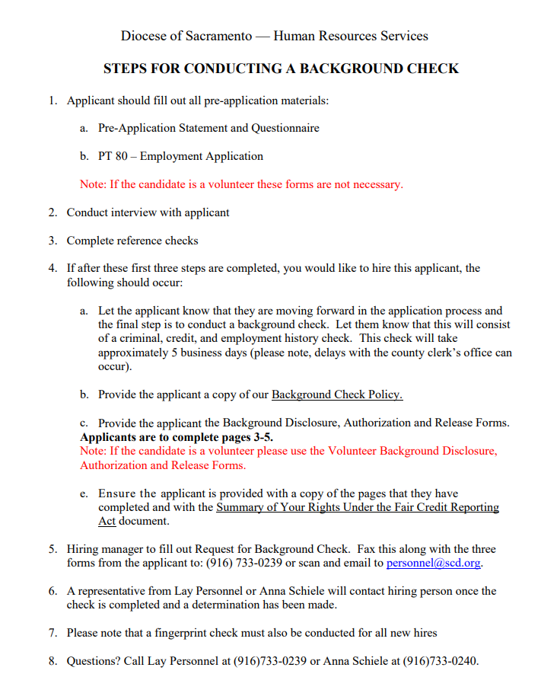
Lay Personnel Background Check Cont’d
Notes:
Be sure to reference the Steps for Conducting a Background Check to guide you through the forms. Two set of forms, one for employees and one for volunteers. Be sure you are using the correct forms. These forms have been updated for legal compliance.

Slide 41
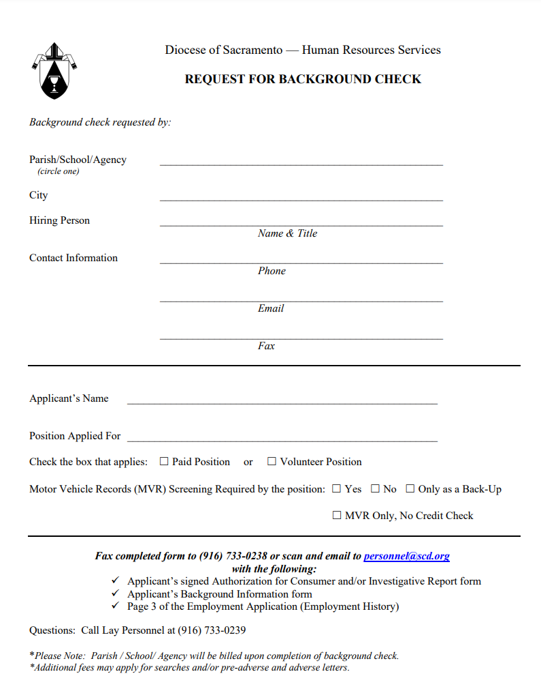
Lay Personnel Background Check Cont’d
Notes:
Note: Background Check Request Form has been updated to clarify the MVR request. Not commonly used but wanted to ensure everyone understood the process. Motor Vehicle Report.

Slide 42
Lay Personnel Background Check Cont’d
All forms for the Background Check can be found by accessing the following link: https://www.scd.org/lay-personnel/lay-personnel-policies-and-forms#background
Notes:
Note: Background Check

Slide 43
Safe Environment Live Scan and Safe Haven Training
Employee vs. Volunteer
Employee cleared DoJ and FBI
Volunteer cleared DoJ only
High School Coaches always DoJ and FBI
If a volunteer becomes an employee, they must be reprinted as an employee.
Parishes and Schools are cleared under different codes – information on fingerprinting cannot be shared between parishes and schools.
School Employee vs. Parish Employee
Parish with school on site – all employees must complete both requirements
Employee Live Scan Verification Form must be submitted to the Safe Environment Office
What to do if employee is working at multiple sites
Compliance Reports
Sent out automatically the first of the month to the site’s Safe Environment Contact
Expiration dates need to be monitored
3 reports:
Staff Complete (all requirements met)
Volunteer complete (all requirements met)
In Progress (volunteer and staff missing one of the requirements – either fingerprinting or training)
Safe Haven Training
Offered through Catholic Mutual Group
Must be renewed every 3 years
Notes:
15% of youth is sexually assaulted/violated by 18 years of age; 90% of those violations are committed by someone they knew.
The employee must complete the screening and training before starting their position. If you are sharing an employee with another site, please contact Safe Environment so they can assist you with ensuring compliance reporting is accurate.
Please Note: If you are rehiring an employee do not assume because they have worked in the diocese that they have already been cleared through Safe Environment. Please contact Safe Environment to determine if the rehire will need to be rescreened as there records may no longer be active. NLI requirements apply.

Slide 44
Sexual Harassment Training
Sexual Harassment Training must be renewed every odd year for the Sacramento Diocese.
All employees will be required to complete the training.
Employees must complete the one hour training
Supervisors must complete the two hour training
All training should have been completed in the Fall of 2023.
New Hires will need to complete training at time of hire and then again in the fall of 2025.
All training is accessed through CMG. More information can be found through the following link:
https://www.scd.org/sites/default/files/2020-12/SCD-Sexual-Harassment-Training.pdf
Notes:
Please note if you have an employee showing active in ADP, then they must complete the required training. Again, if the employee is not active you must terminate them in ADP. If you have an employee who is seasonal such as a musician or a substitute teacher, you must ensure they complete the required training and pay them for the time that it took to complete.

Slide 45
LOA’s and WC Cases
LOA forms are required to be completed anytime an employee is out of work for more than 7 days.
LOA Forms and information can be found by accessing the following link: https://www.scd.org/lay-personnel/leave-absence
WC Paperwork must be completed immediately after an accident.
WC Forms and information can be found by accessing the following link: https://www.scd.org/lay-personnel/workers-compensation-forms
LWP Claims Solutions
Robin Mays, Senior Claims Adjustor
Phone: 916-609-3665
Email: r_mays@lwpclaims.com
Note: A WC incident requiring the employee to be off of work for more than 7 consecutive days will also require the leave of absence paperwork to be completed.
All accommodation/restriction request must be reviewed with the HR Director before returning the employee back to work.
Notes:
Pregnancy, medical self, medical other, ineligible
WC:
First Aid – no medical assistance needed
DCW1 must be completed by employer and employee and a copy of the completed form provided to employee to take to the doctor
5020 must be completed by the employer
All forms must be provided to LWP

Slide 46
Insurance Stoploss
Must remove employee from our benefits if out longer than 6 months
Per our policy, “An employee taking medical/family leave will be allowed to continue participating in any employee benefit plans in which he/she was enrolled before the first day of the leave (for the duration of the approved leave up to the maximum of 6 months) at the level and under the conditions of coverage as if the employee had continued in employment for the duration of such leave.”
After the 6 month period must offer Continuation of Coverage
Loss of reimbursement if we do not follow our policy
Notes:
Read Slide

Slide 47
Termination Requirements
All terminations must have prior approval from the HR Director and Legal. Failure to receive approval will result with the loss of liability insurance provided by Catholic Mutual.
This includes any lay-off’s.
Performance Concerns need supporting documents
Reviews, PT900’s, PIP’s
Only exception is when an employee voluntarily resigns.
Completing documents at the time of termination
Separation Checklist PT690 From
Notes:
Note: Ensure you are utilizing the Separation Checklist PT690 Form. Provide information regarding the 403(b), which is administered by The Standard. We receive a lot of feedback that they were not informed of their benefit. Final pay must be provided at the time of separation. Identify if they are rehireable on the PT200 Form.

Slide 48
ADP – Time & Attendance
All sites have been successfully transition to Time and Attendance, the electronic time keeping system with ADP
Audits will be occurring in the Summer/Fall to ensure compliance with reporting requirements
Electronic Approvals
Direct supervisor must review and approve the timesheet after the employee (i.e. Pastor, Principal)
This is an organizations largest expense and must be approved for the payroll administrator to administer the pay
If there are changes with the supervisor or payroll processor a PT200 needs to be completed before the changes in Time and Attendance can be made.
Punch Corrections and Edits must be requested by the employee using the PT503 Form
Everything is tracked in ADP, we can see what was entered, by who and when
Ensures compliant with Labor Laws
Meal premiums cannot be removed
OT obligations will be met
Wage and Hour Claims are not covered by Catholic Mutual
Notes:
PT502 Meal Break Waiver, PT505 Make Up Time Request, PT510 for Overtime Requests
Reminder: Payroll Processors must be vetted and cleared through Lay Personnel before they will be granted access to the system.
Note: If an employee has an ADA Accommodation Request that would preclude them from using the electronic timekeeping system, it must be reviewed and approved by the HR Director.
ADP does have a plethora of resources and tools available on the ADP Bridge. Tutorials may even be available.

Slide 49
ADP – Time & Attendance Cont’d
Updated sick time requirements
All employees must accrue 40 hours of sick time
24 hours by 120 days of employment*
40 hours by 200 days of employment*
* We will need to adjust those working part-time or less to ensure they are accruing the sick time per the above threshold. We are working with ADP now to determine a resolution
Accrual caps were updated for compliance with new requirements

Slide 50
ADP Wage Rate Programs
Wage Rate Programs define specific rates of pay used for specific labor charge value combinations.
Generic vs Employee Specific
Only 1 wage rate program can be assigned to an employee, but rates can be defined to include multiple department codes.

Slide 51
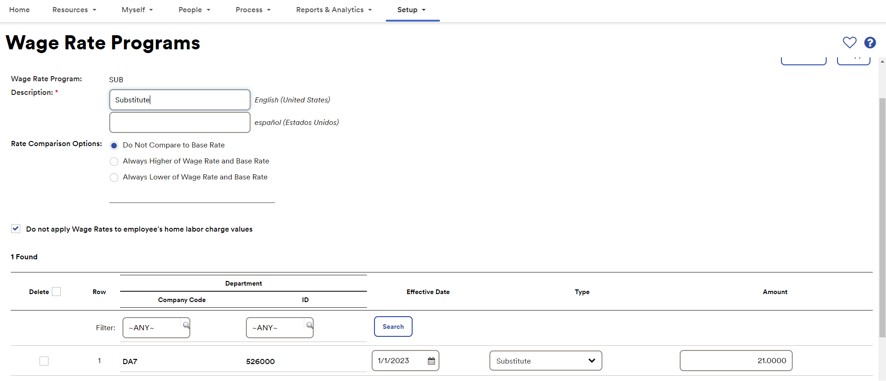
ADP Wage Rate Set-up
SETUP> Time & Attendance> Wage Rate Programs
To assign: PEOPLE> Employment> Employment Profile> Time & Attendance Tile> Edit> select Wage Rate Program

Slide 52
Misc. Payroll Items
Minimum Wage Increase Jan. 1, 2023:
New hourly minimum of $16.00/hour.
New salary minimum of $66,560 annually.
Please Note: If the employee is a teacher, the rates above do not apply to them as they have a different pay scale that is released from the Catholic School Department. The teacher salary can only be applied to those teaching TK-12th grade.
Advised COLA Increase July 1, 2024:
4.5% increase
Bonuses
While we do not advise providing bonuses, if a bonus is provided it must be processed through payroll.
Stipends
Employees cannot be paid stipends. They earn wages and must be provided wages in accordance with labor laws.
W-2’s can only be obtain from employed site or payroll processor not the Pastoral Center
EITC required notice in January and March of each year
Notes:
Read slide

Slide 53
Misc. Payroll Items Cont’d
Wage and Hour Concerns
Employees cannot volunteer their time for duties they are compensated to perform.
Volunteers cannot be paid or compensated in other ways.
Additional duties for teachers should be included in the contract with correlating pay (i.e. coaching, summer school, tutoring).
When employing Nuns/Sisters must reach out to Lay Personnel.
Must be provided with a nun contract unless on a teacher contract
Must be provided with the same wages and benefits as lay employees, unless approval from Mother Superior
This includes sick, vacation and holiday hours
Must undergo same screening processes as lay employees (i.e. background check and livescan)
Should not be set-up as an independent contractor unless they would qualify as a lay independent contractor
Notes:
Read slide

Slide 54
Workplace Violence Policy and Training
Employers are now required to adopt workplace violence prevention plans.
Utilize the Workplace Violence/Workplace Security Prevention Plan document template created to modify for your site-specific information.
A copy of this plan is to be kept in the IIPP Binder.
Each employee at the time of hire should be provided with the IIPP Binder to review.
Annual training is to be conducted which must include the following:
A review of the Workplace Violence/Workplace Security Prevention Plan
Definition of workplace violence
Workplace violence as the act or threat of violence, ranging from verbal abuse to physical assaults, directed toward people at work or on duty. Workplace violence also may include acts that result in damage to an organization's resources or capabilities. Many employers consider workplace harassment and bullying to be forms of workplace violence. Also included in this context is domestic violence that spills over into the workplace in the form of assaults, threats or other actions by outside parties with whom employees have relationships and that occur at the workplace.
4 Types of workplace violence
Criminal Intent
Customer/Client
Worker on Worker
Personal Relationship
Workplace violence hazards specific to the employees’ jobs
How to protect themselves and report workplace violence
Notes:
Read Slide

Slide 55
Workplace Violence Policy and Training Cont’d
Typology of Workplace Violence
Type | Description
I. Criminal Intent | The perpetrator has no legitimate business relationship to the workplace and usually enters the affected workplace to commit a robbery or other criminal act.
II. Customer/client | The perpetrator is either the recipient or the object of a service provided by the affected workplace or the victim. The assailant may be a current or former client, patient, customer, passenger, criminal suspect, inmate, or prisoner.
III. Co-worker | The perpetrator has some employment-related involvement with the affected workplace. Usually this involves an assault by a current or former employee, supervisor or manager.
IV. Personal relationship | The perpetrator is someone who does not work there but has or is known to have had a personal relationship with an employee.
Notes:
Read Slide

Slide 56
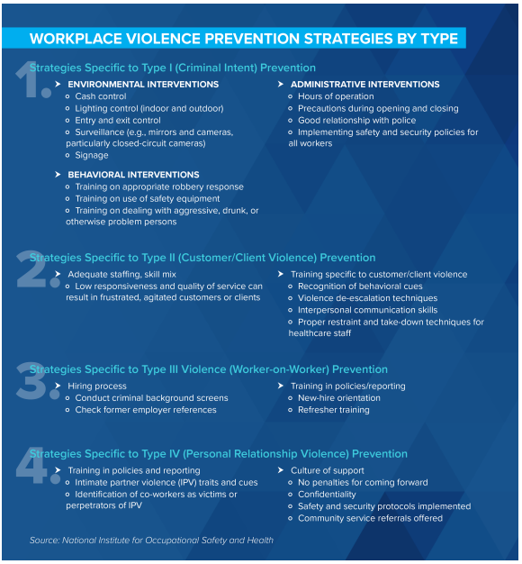
Workplace Violence Policy and Training Cont’d
Notes:
Read Slide

Slide 57
Breakroom Postings
All sites have been provided with custom made California and Federal Employment Notice Posters
Religious employers have a religious exemption for some laws, we should not be posting laws that do not apply to us
Safe Environment postings were sent in 2023
Child Welfare Services Information
Victim Assistance Poster
Action to take:
Post updated posters, ensure all posters not provided by the Diocese have been removed
Notes:
Note: Spanish have not been updated yet.

Slide 58
COVID-19 Items
Occurrence Reporting no longer in effect.
Quarantine Protocol
Employee COVID Positive with symptoms
To return to work the employee must meet the following criteria:
At least 24 hours have passed since symptom onset and at least 24 hours have passed since resolution of fever without the use of fever-reducing medications; and other symptoms are mild and improving.
When the employee returns to work, they must wear a mask for 10 days from the start of symptoms.
Employee COVID Positive with no symptoms
COVID -19 cases with no symptoms, there is no infectious period for the purpose of isolation or exclusion. If symptoms develop, the criteria above will apply.
The employee must wear a mask for 10 days from the date of testing positive.
Exposed Employee
Employees who have been exposed do not need to quarantine unless they begin to exhibit symptoms. If symptoms develop, the criteria above will apply.
The employee must wear a mask for 10 days from the date of exposure.
COVID Resources
https://www.scd.org/lay-personnel/coronavirus-covid-19
Notes:
Occurrence Reporting no longer in effect.
As updates are communicated through the Weekly News, all communication is posted on the Lay Personnel COVID page on the Diocesan Website.
Memo sent out on Feb. 5, 2024
Cal OSHA and the California Department of Public Health have updated COVID-19 Guidelines. As such we have updated our protocols to align our practices, the following are our current safety protocols for employees:
Use of Masks
Face coverings will only be required in the following circumstances:
An outbreak has been reported, OR
While using employer-provided transportation, OR
CDPH has implemented a mask mandate.
Note: While face coverings are not required, they are highly encouraged.
Employer must supply an unvaccinated employee with a N95 mask upon request.
Employer must allow employees to wear face coverings if they voluntarily choose to do so, unless it would create a safety hazard, such as interfering with the safe operation of equipment.
International Travel
All employees (regardless of vaccination status) will ONLY need to quarantine after international travel if the following apply:
The employee is feeling symptomatic or
The employee has been exposed to COVID
Note: All employees should proactively take a COVID test 3-5 days after returning to California in compliance with the CDC recommendation.
Please check the CDC website prior to international travel to ensure no additional restrictions apply.
Screening and Quarantine
Self-Screening Measures
Please ensure you refrain from reporting to work on-site if you are not feeling well or are experiencing COVID symptoms.
During the workday, if an employee begins to feel ill and exhibit any of the symptoms of the virus, especially a fever, a changing cough, or difficulty breathing, the employee should leave work immediately while wearing a face covering until they have exited the premises. After leaving the building, the employee is to immediately contact Lay Personnel to notify them that they are feeling ill and have left the building to ensure the safety of others. Lay Personnel will then notify the appropriate supervisor.
The employee is expected to be in regular communication with Lay Personnel regarding the status of their condition. Further direction will be provided to the employee based upon their condition (such as the ability to work remotely, return to work date, etc.), the employee is expected to follow the direction provided including the required check-ins with Lay Personnel or their supervisor.
Note: Locations outside of the Pastoral Center should be informing and communicating with their respective Management Team opposed to Lay Personnel.
Quarantine Protocol
Employee COVID Positive with symptoms
The employee will be asked to provide a list of the people in the building that they have had physical contact with 72 hours before the onset of symptoms.
To return to work the employee must meet the following criteria:
At least 24 hours have passed since symptom onset and at least 24 hours have passed since resolution of fever without the use of fever-reducing medications; and other symptoms are mild and improving.
When the employee returns to work, they must wear a mask for 10 days from the start of symptoms.
Note: The date of exposure (or start of symptoms if exposure is unknown) is day “0”. Day “1” is the first full day after the day of exposure (or start of symptoms if exposure is unknown).
Employee COVID Positive with no symptoms
The employee will be asked to provide a list of the people in the building that they have had physical contact with 72 hours before the onset of symptoms.
COVID -19 cases with no symptoms, there is no infectious period for the purpose of isolation or exclusion. If symptoms develop, the criteria above will apply.
The employee must wear a mask for 10 days from the date of testing positive.
Note: The date of testing positive is day “0”. Day “1” is the first full day after the date of testing positive.
Exposed Employee
Employees who have potentially been exposed to the virus will be immediately informed.
Employees who have been exposed do not need to quarantine unless they begin to exhibit symptoms. If symptoms develop, the criteria above will apply.
The employee must wear a mask for 10 days from the date of exposure.
Note: The date of exposure is day “0”. Day “1” is the first full day after the day of exposure.
Pay During Quarantine
Accrued Sick or Vacation Hours
The employee may either use their accrued sick or vacation hours to cover their missed time. Please note the employee will need to request the use of their sick or vacation hours via the PT501 Form or an electronic time off request in ADP.
Pay for Required Testing
If an employee is required to obtain a COVID test due to a workplace exposure or to return to work, then the employer must pay the employee for the time required to obtain the test. The employee must inform the supervisor of the time required to obtain the test, the employer will then need to enter the hours onto the employee’s timesheet. The employer should make a note on the timesheet that the hours paid are due to obtaining a COVID test.
General
No physical distancing or barriers between workers are required, regardless of employees’ vaccination status in the workplace.
Infectious Disease Preparedness and Response Plan
Each employee at the time of hire should be provided with a copy of this plan.
A copy of this plan is to be kept in the IIPP Binder.
An updated version has been added to the Diocesan Website. Please be sure to use the most current draft. For your convenience we have provided the following link to access this document: https://www.scd.org/sites/default/files/2023-03/Infectious%20Disease%20Preparedness%20and%20Response%20Plan%20v8%20-%20Final%203.23.pdf

Slide 59
Equifax
All unemployment claims must be submitted to Equifax.
Equifax Workforce Solutions
Attention: Liza Parodi
Fax: (866) 219-8832
Phone: (833) 946-0624 ext. 7691
Email: liza.parodi@equifax.com
Notes:
Read Slide, new contact as Nancy has retired.

Slide 60
The Work Number
All Employment Verifications should be conducted through The Work Number.
Accessing The Work Number
Start by going to www.theworknumber.com
Select “Log In” and follow the simple prompts
Enter the Employer code 26785
If this is your first time – pick “Register Now”
If a returning user – enter your username and password you set up.
The screens prompts will walk you through all the steps to help verify your identity and keep your account private while offering helpful messages if you have problems.
A more detailed guide can be found by accessing the following link:
https://www.scd.org/sites/default/files/2021-03/Employee_Guide%20to%20The%20Work%20Number%20%28March%202021%29_0.pdf
Notes:
Read Slide

Slide 61
Weekly News on Website
Important to read:
Updates from all departments
Always available on the website if not emailed to you (left hand side of home page)
Distributed on Mondays (unless it is a holiday)
Notes:
Read Slide

Slide 62
Increased Insurance Premium
Sites that are not compliant with the requirements outlined out in this presentation will incur a 25% increase in insurance premiums
Notes:
By not following the compliance measures outlined out in this presentation you are inherently taking on a greater risk of liability as the result the cost of insurance will be increased.
This is no different than auto insurance. If you are in an accident, your insurance goes up.

Slide 63
Miscellaneous Bookkeeping Items

Slide 64
Misc. Bookkeeping Items – Internal Controls
Controls over bank accounts ( signers, review statement/recon, no blank checks)
Controls over Other Income

Slide 65
Misc. Bookkeeping Items – Diocesan Statues
Contractor vetting/ documentation. Diocesan Approval (Statue 146)
Sacramental Offerings (Statute 151)
Excess parish/school funds to PFI (Statute 153)

Slide 66
Misc. Bookkeeping Items – Administrative Oversight
Compensation of non-employees.
Pastoral/Finance Council Items.
Diocesan Deliverables

Slide 67
Wrap –Up and Questions?

