Slide 1
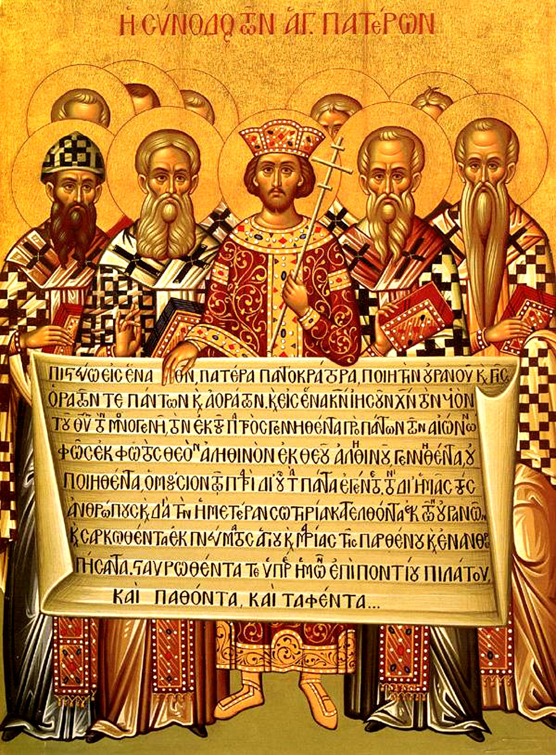
Invitation to Reflect and Share
Think, Reflect, Pray, or Write
Share with your groups
The Creed

Slide 2
When Jesus asked his disciples, “who do people say that I am?”, there were many responses. Then Jesus asked, “Who do YOU say that I am?” What is your answer to that question.
What reality is the Profession of Faith based on?
There are many points professed in the Creed… which point resonates with you the most?
The Creed
Points for you to Ponder
I Believe in One, Holy, Catholic, and Apostolic Church

